Slide 1
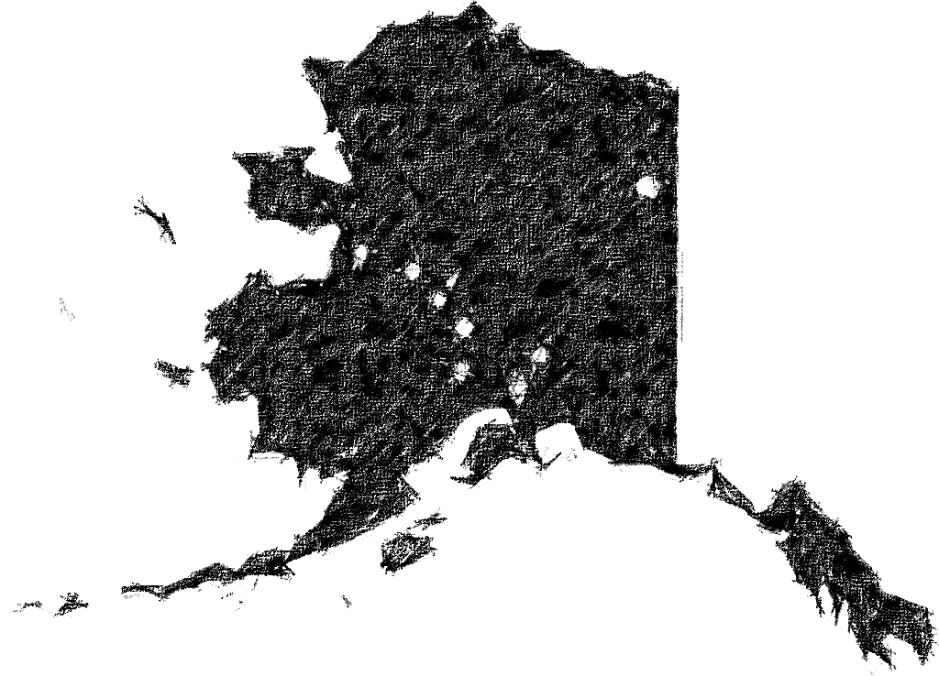
Mining for Context in Alaska Hotel Reviews
What’s in a Tripadvisor Review?
“We didn't get up early to check out the free breakfast and rather took a cab to Denny’s”
“They have coffee but offer powdered cream. This was so disappointing not the best part of our trip at all...”
“Sucks”

Slide 2
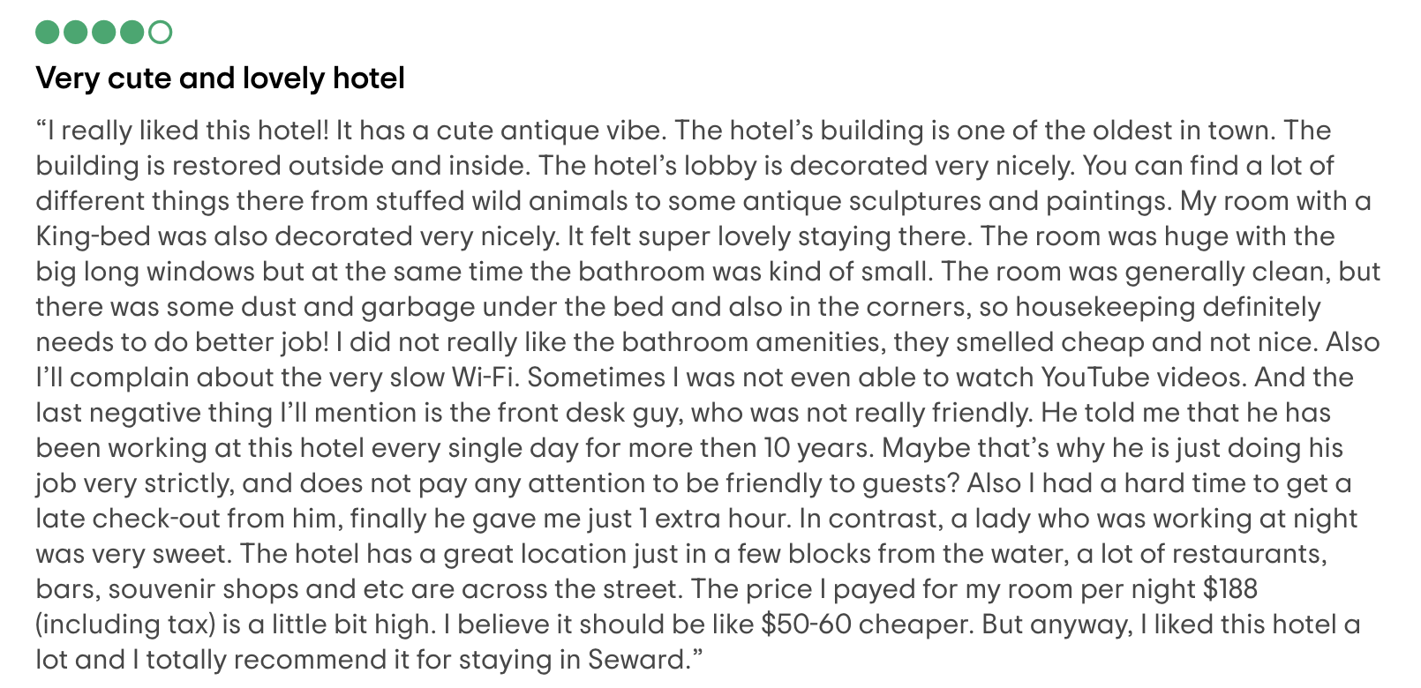
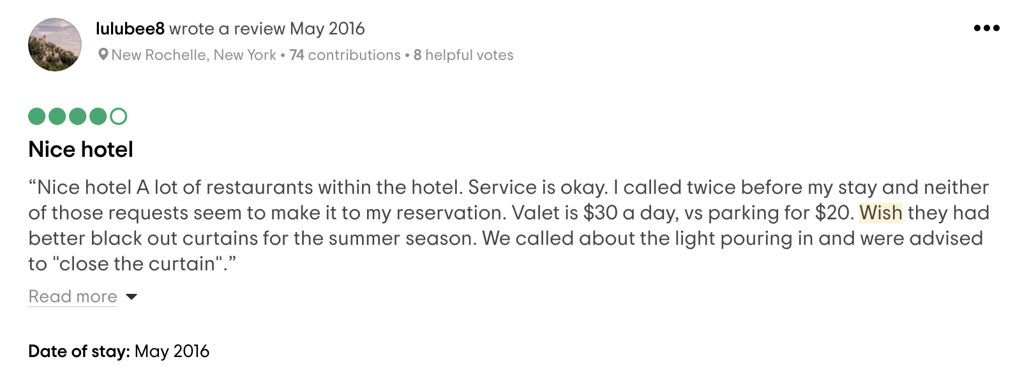
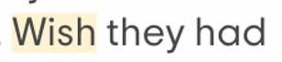
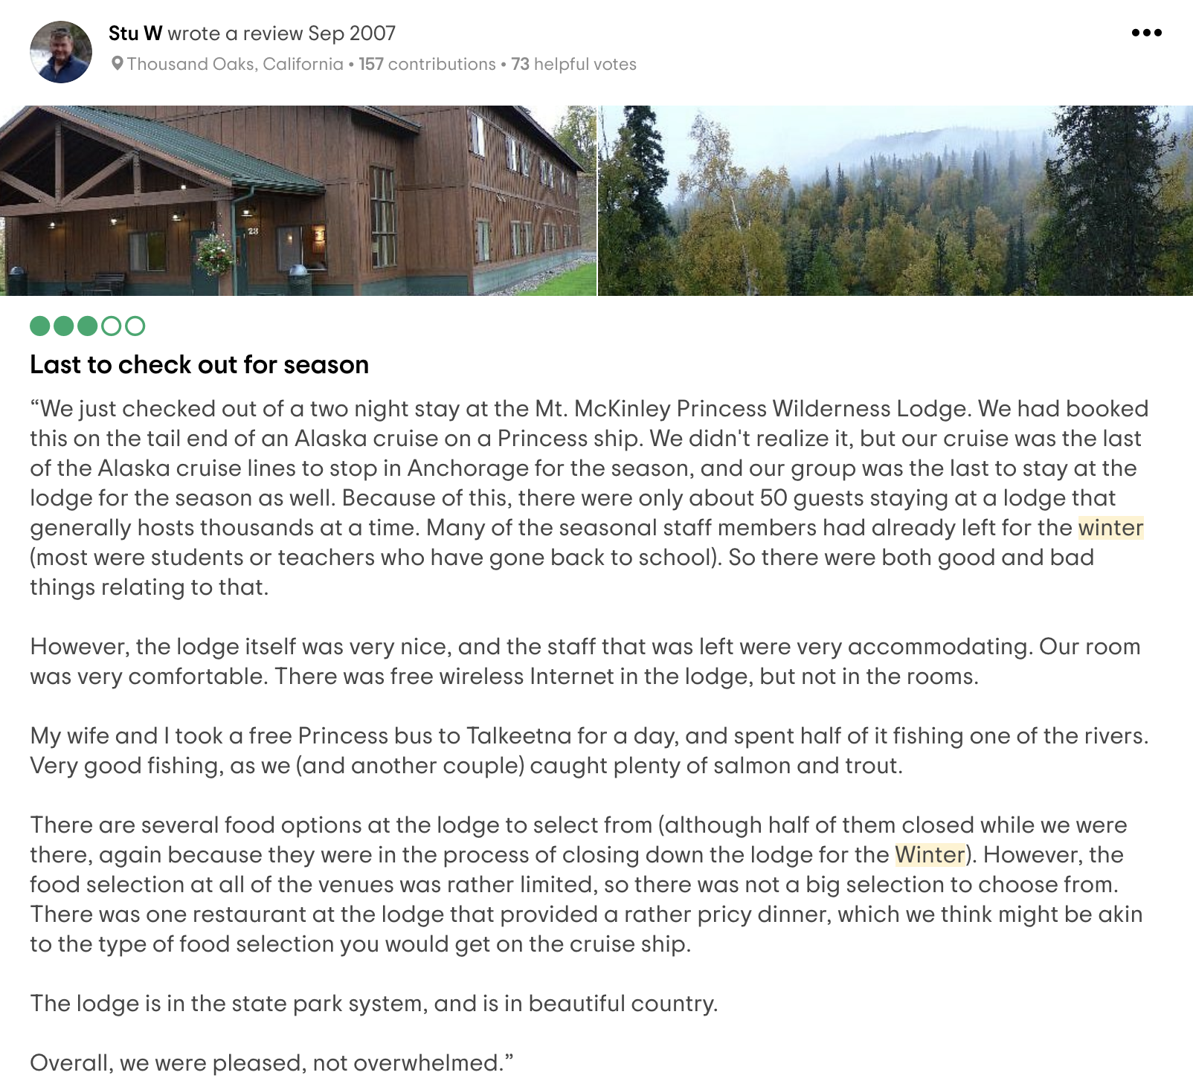
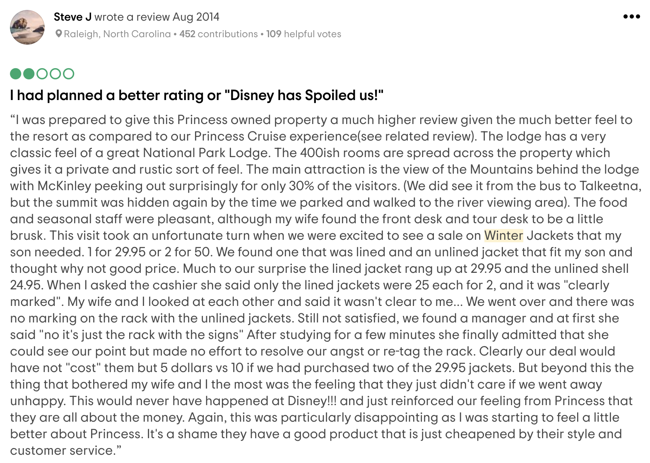
Overview
Main data source
Scraped Tripadvisor reviews of hotels and properties in Alaska
Corpus
77,740 reviews
7,378,484 words
Main tools
NLTK
SymSpell
SpaCy
Vader
CorEx
Objective
Topic modeling with CorEx and topic-based review filter application

Slide 3
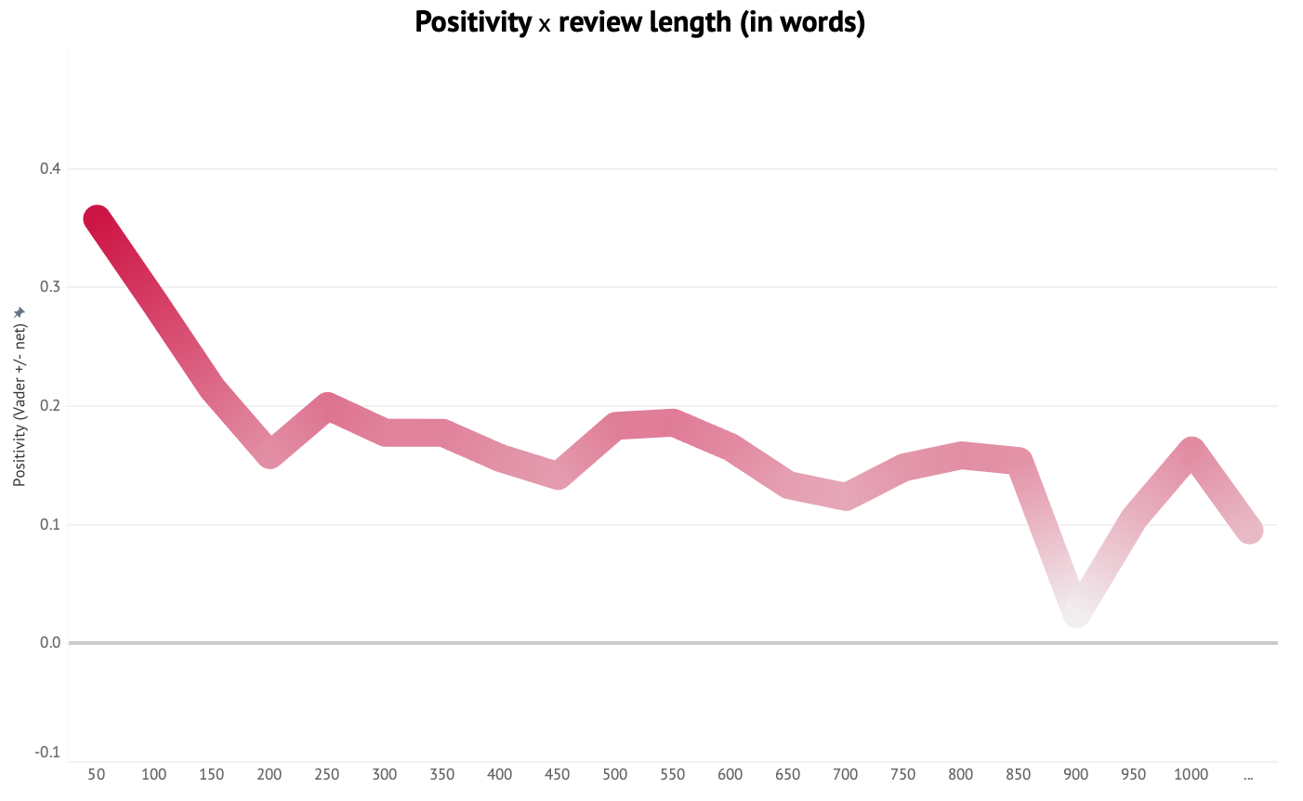
Longer reviews are more negative
GREAT!
Positivity (in Vader +)
First, I have to say that I never write reviews. But from the moment we arrived at this dump it was clear that the owner and his family are complete jokes and incapable of good in any sense and likely...
Review length (in words)

Slide 4
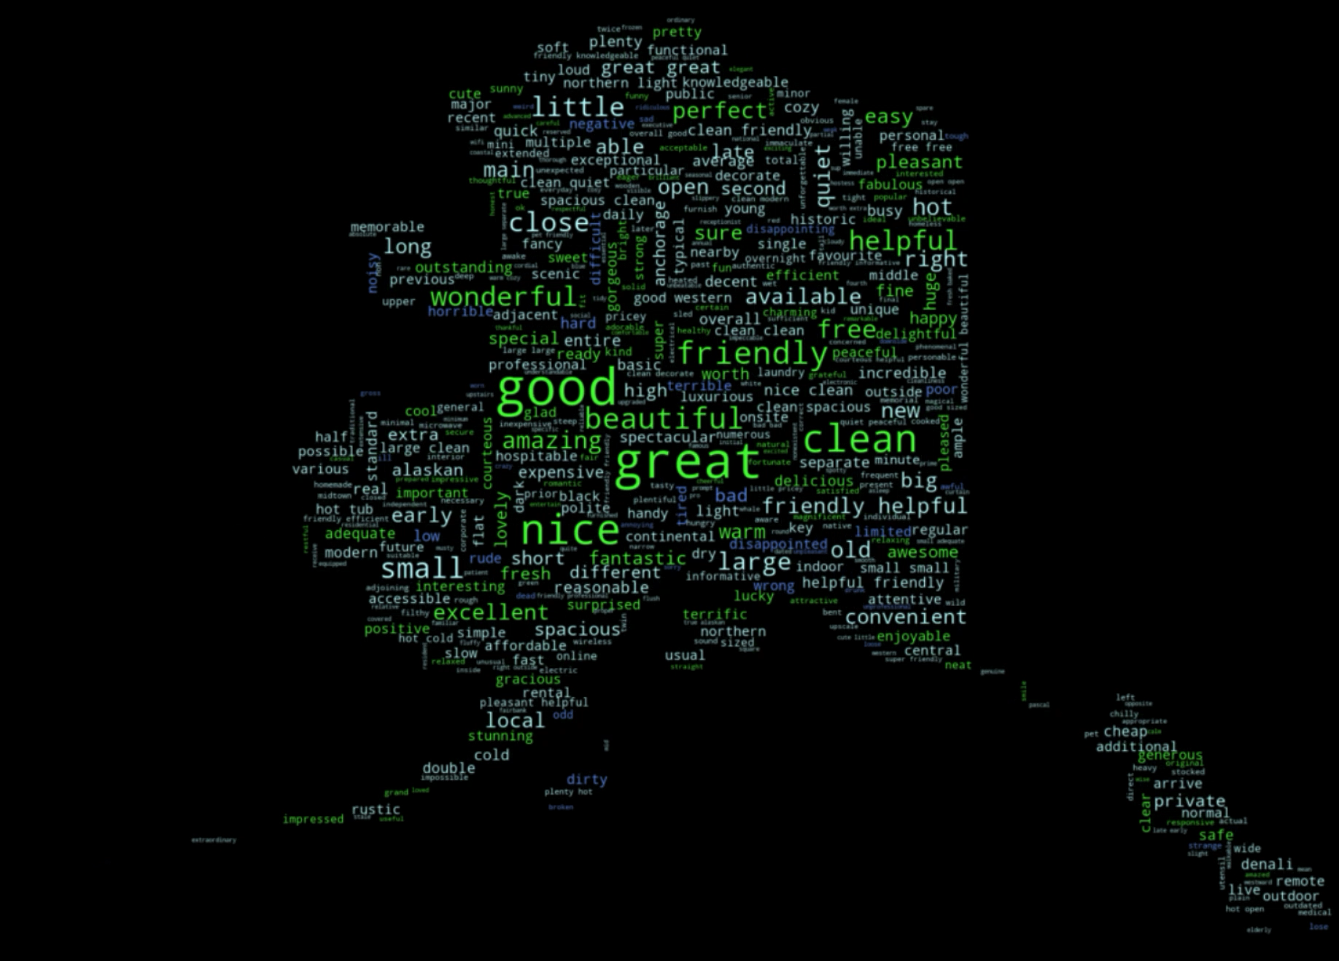
Adjectives change (slightly) by season
Sentiment range by season
Spring
0.364028
Summer
0.353218
Fall
0.363560
Winter
0.374927

Slide 5











11 topics
Arrival
hotel | shuttle | desk | airport | staff | lobby
Room
kitchen | bedroom | bathroom | living | living room
| private | share | bath
Atmosphere
host | home | feel | wonderful | make feel | delicious
| house | family
Surrounding area
downtown | walk | distance | walk distance | location
| locate | restaurant | easy | free | town
Annoyances/quirks
floor | noise | window | wall | open | shower | door
| carpet | fan | sleep
Food
food | dinner | eat | meal | lunch | food good | menu
Breakfast
coffee | microwave | bed | breakfast | fridge | queen
| fruit | egg | tv | cereal
Check-in/check-out
check | tell | arrive | say | review | ask | book | leave
| reservation | bad
Touring Alaska
par | denali | national park | national | tour | princess
| bus | train | rv
Local scenery
view | mountain | great view | deck | beautiful
| overlook | view room | beautiful view
Fishing
fishing | fish | guide | salmon | trip | bear | catch | boat
| halibut | experience
CorEx parameters
Vectorizer
TfidfVectorizer
max_df
0.5
min_df
5
ngram_range
(1, 2)
anchors
["hotel", "lodge"]
["aurora", "northern lights"]

Slide 6
11 topics
Arrival
hotel | shuttle | desk | airport | staff | lobby
Room
kitchen | bedroom | bathroom | living | living room
| private | share | bath
Atmosphere
host | home | feel | wonderful | make feel | delicious
| house | family
Surrounding area
downtown | walk | distance | walk distance | location
| locate | restaurant | easy | free | town
Annoyances/quirks
floor | noise | window | wall | open | shower | door
| carpet | fan | sleep
Food
food | dinner | eat | meal | lunch | food good | menu
Breakfast
coffee | microwave | bed | breakfast | fridge | queen
| fruit | egg | tv | cereal
Check-in/check-out
check | tell | arrive | say | review | ask | book | leave
| reservation | bad
Touring Alaska
par | denali | national park | national | tour | princess
| bus | train | rv
Local scenery
view | mountain | great view | deck | beautiful
| overlook | view room | beautiful view
Fishing
fishing | fish | guide | salmon | trip | bear | catch | boat
| halibut | experience
34694 reviews
18128 reviews
16772 reviews
22408 reviews
CorEx parameters
22562 reviews
16666 reviews
Vectorizer
TfidfVectorizer
max_df
0.5
min_df
5
ngram_range
(1, 2)
anchors
["hotel", "lodge"]
["aurora", "northern lights"]
24582 reviews
20514 reviews
23634 reviews
9382 reviews
19743 reviews
Notes:
19.55 TC

Slide 7
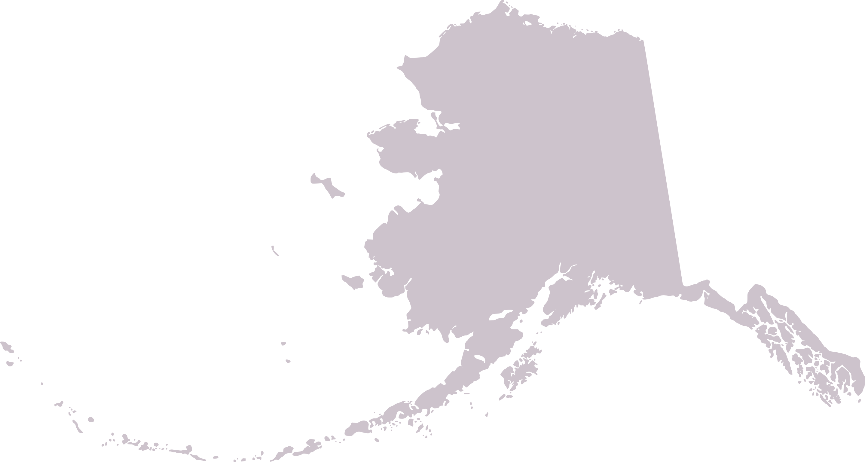
Topics change with latitude
71.299240,
-156.746628 (Utqiagvik)
Topic 1:
Arrival
p(y|x)
Topic 5:
Annoyances
p(y|x)
Way
north
North
Mid
Lower
Panhandle
0.479758
0.503360
0.346276
0.153456
0.199507
0.177564
0.275063
0.296263
0.307281
0.340982
55.299671,
-131.557037
(Ketchikan)
This Photo by Unknown Author is licensed under CC BY-SA
Notes:
1104 miles
-Latitude71 B and B at very tip

Slide 8
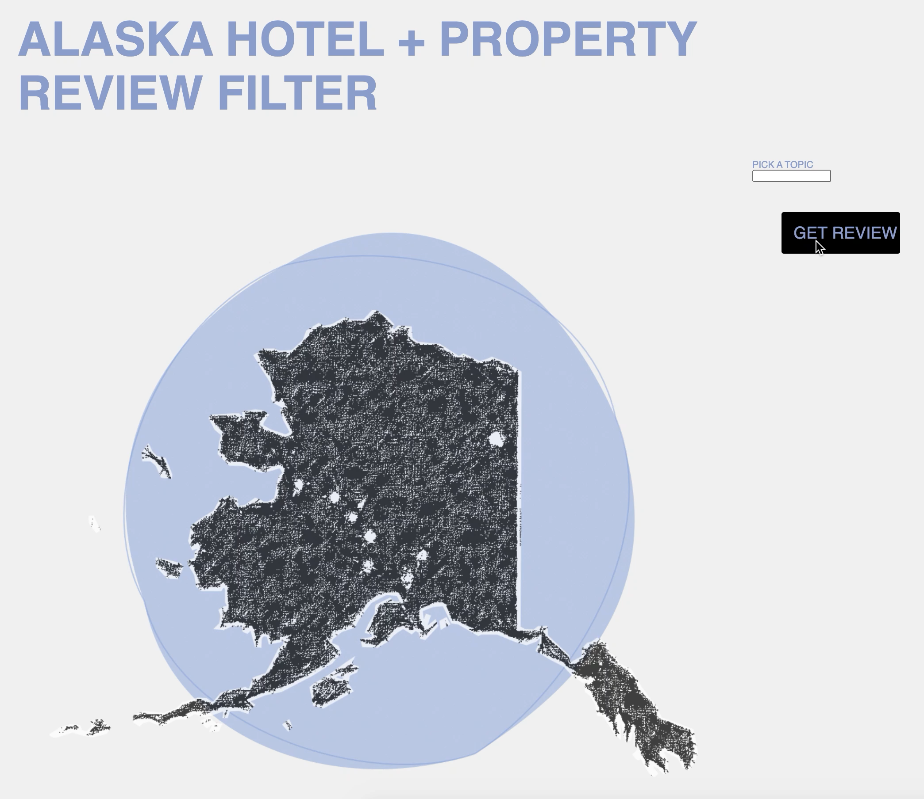
Review filter 1.0
To come
Season filter
Aurora-mention filter
Weather filter
Love/beauty filter
Hate/never filter
Distance filter (how far did the person travel?)
Ratio-of-pronouns-to-other names filter
In-review-comparisons-to-other-properties filter
Solo/group filter
Time-elapsed-between-stay-and-published-review filter
...

Slide 9
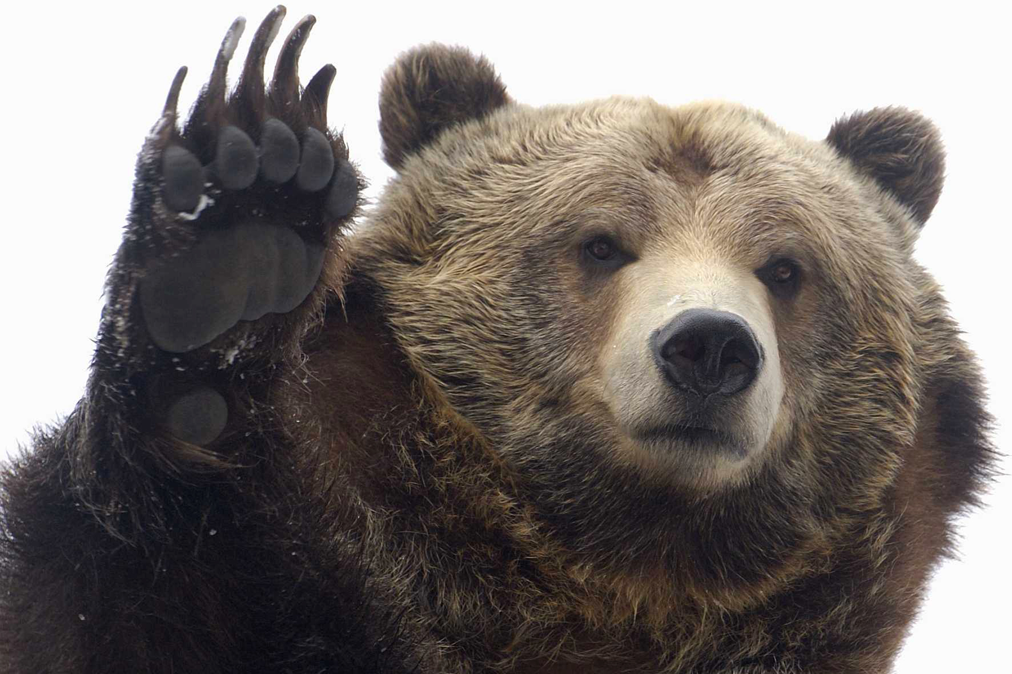
References
Nurfikri, Fahmi, “Create Word Cloud into any Shape you want using Python,” https://towardsdatascience.com/create-word-cloud-into-any-shape-you-want-using-python-d0b88834bc32
Mueller, Andreas, “Colored by Group Example,” https://amueller.github.io/word_cloud/auto_examples/colored_by_group.html
“NLP-with-Python,” susanli2016 on GitHub, https://github.com/susanli2016/NLP-with-Python/blob/master/Web%20scraping%20Hilton%20Hawaiian%20Village%20TripAdvisor%20Reviews.py
County FIPS Codes, USDA, https://www.nrcs.usda.gov/wps/portal/nrcs/detail/?cid=nrcs143_013697
Space Weather Prediction Center, NOAA, https://www.swpc.noaa.gov/news/improved-aurora-forecasts-at-the-space-weather-prediction-center
This Photo by Unknown Author is licensed under CC BY-NC

